Slide 1
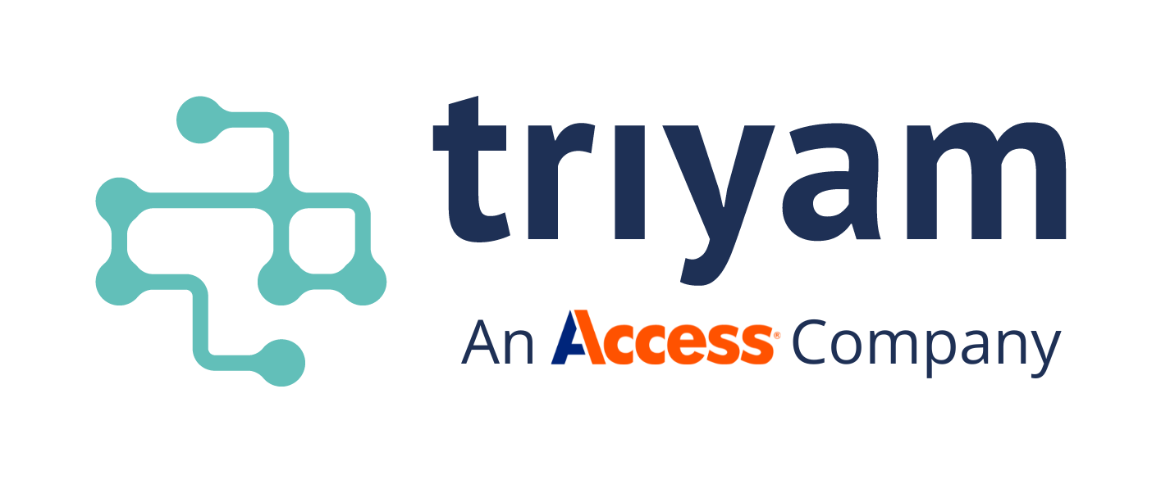
Beyond the Data Deluge: Practical Solutions for Healthcare IT Leaders
www.triyam.com

Slide 2






Introduction - Meet the Presenters​
Sudhakar Mohanraj
Founder & CTO, Triyam
20+ years in US Healthcare IT — EHRs, HIEs, RCM, Data Archival
The information in this document is proprietary and confidential to Triyam and cannot be disclosed without prior written consent.

Slide 3

Beyond the Data Deluge: Practical Solutions for Healthcare IT Leaders
The information in this document is proprietary and confidential to Triyam and cannot be disclosed without prior written consent.

Slide 4




Introduction - Meet the Presenters​
Shawna Serio
Sr. Solutions Engineer, Triyam
Expert in RCM, EHR systems & data compliance
The information in this document is proprietary and confidential to Triyam and cannot be disclosed without prior written consent.

Slide 5
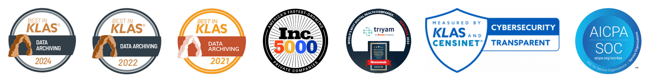
At Triyam, we are experts at what we do and deliver a Best in KLAS service and solution
8k+
500+
Triyam is part of Access, the world’s largest private records management company. We’ve been named Best in KLAS for Data Archival in 2021, 2022, and 2024, and featured on the Inc. 5000 list four years in a row. Most recently, in 2024, Newsweek recognized us as one of the World’s Best Digital Health Companies.
12+
LIVE
USERS
LEGACY
SYSTEMS
ARCHIVED
YEARS OF
EXPERIENCE
60M+
150+
95+
NO OF PATIENTS
DATA PRESERVED
NO OF TRUSTED
CLIENTS
KLAS RATING
APRIL 2024
The information in this document is proprietary and confidential to Triyam and cannot be disclosed without prior written consent.

Slide 6

Let’s Start Light!
What’s been your worst data-related nightmare?
Spreadsheet crashes?
System overload?
A facepalm moment with data?
Let’s hear a few fun (or scary) stories!
The information in this document is proprietary and confidential to Triyam and cannot be disclosed without prior written consent.

Slide 7

How Big Is Healthcare Data Right Now?
🚀 Fun Fact: Just How Big is 10,000 Exabytes?​
That’s enough to fill over 50 trillion books.
The Healthcare Data Tsunami​
By 2025, healthcare will generate​
10,000 exabytes — that’s 10 zettabytes of data!
📚 Stacked up, they’d reach Neptune—the farthest planet from Earth—and back. Twice.
Did you know?
Healthcare accounts for 30% of the world’s data — more than any other industry.
That’s a journey of
over 5.6 billion miles!​
Source
1. L.E.K. Consulting
2. Science Direct: Global Health Journal
The information in this document is proprietary and confidential to Triyam and cannot be disclosed without prior written consent.

Slide 8
Poll Question #1
If we start at 10 ZB in 2025 and compound at 35% annually…
What will the data size be in 10 years?
20 ZB
30 ZB
100 ZB
200 ZB
500 ZB
Too big to calculate
Let's see what you think!
The information in this document is proprietary and confidential to Triyam and cannot be disclosed without prior written consent.

Slide 9
Data Growth
201.1 ZB
200
175
The Data Deluge is Real
150
Healthcare data is increasing at a staggering 35% annually.
125
110.3 ZB
Healthcare Data Volume (Zettabytes)
100
75
50
32.2 ZB
25
10.0 ZB
2025
2029
2033
2035
Year
Source
1. L.E.K. Consulting
2. RBC Captial Markets
The information in this document is proprietary and confidential to Triyam and cannot be disclosed without prior written consent.

Slide 10

Where is the data deluge coming from?
EHRs​
Medical imaging​
Networked medical devices​
Payer records​
Pharma research​
Sources of Healthcare Data
Genomics​
Remote patient monitoring​
Wearable devices
HIEs, and patient & provider portals​
Source
1. American Hospital Association Report
2. Executive Levels: Industry Insights
The information in this document is proprietary and confidential to Triyam and cannot be disclosed without prior written consent.

Slide 11
Poll Question #2
Which Area of Healthcare Data Growth Feels Most Unmanageable for Your Organization Right Now?
(Unlike the last poll, there’s no right or wrong answer—this one is all about your organization and your reality.)
You may select more than one option:
📸 Imaging and video data
⌚ Wearables and remote monitoring
📝 EHR and clinical notes overload
🔗 Integration across disparate systems
🔒 Security risks and dark web threats
The information in this document is proprietary and confidential to Triyam and cannot be disclosed without prior written consent.

Slide 12


How do we manage this?
Industry best
practices for
managing data
are endless
You Can’t Do It All — Pick Smart, Practical Solutions​
The information in this document is proprietary and confidential to Triyam and cannot be disclosed without prior written consent.

Slide 13

Deployment Models
Cloud = Scalable + Flexible​
Unified access
Choose the Right Deployment
Strategy
On-prem = Control + Security​​
​Real-time insights​
Hybrid / Edge = Best of Both​​ Build a Data Fabric to connect all systems​
Cross-environment sync
The information in this document is proprietary and confidential to Triyam and cannot be disclosed without prior written consent.

Slide 14

Gartner Informal Survey – 2025
Security &
Governance
Workload Reversal​
95% of executives agree: Cloud apps require different governance and security than on-prem apps
18% of organizations are moving
workloads back to on-prem
— with cost Cited as
Insights on How Healthcare Providers Are Approaching Deployment Strategy
the primary driver​​
Top Cloud Concerns​
Platform Adoption​
44% of respondents say cost is the biggest challenge with cloud
21% are concerned about being locked into a single vendor
62% use Microsoft Azure
20% use AWS
18% rely on other cloud providers
The information in this document is proprietary and confidential to Triyam and cannot be disclosed without prior written consent.

Slide 15

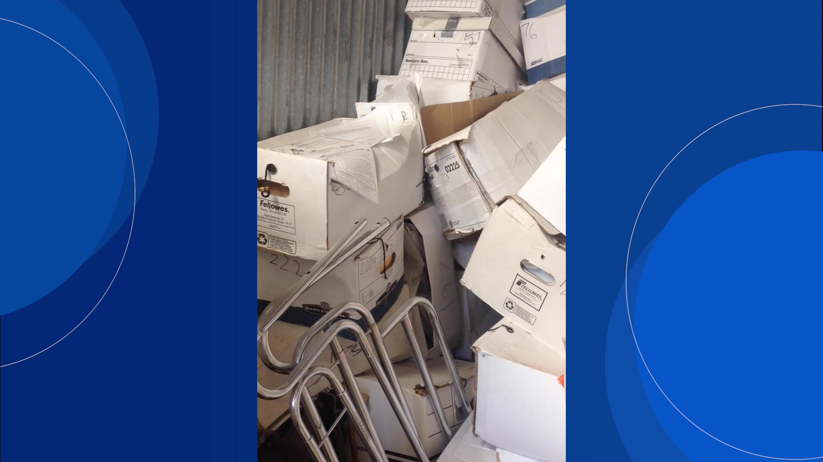
A Real-World Look at Physical Data Management
The information in this document is proprietary and confidential to Triyam and cannot be disclosed without prior written consent.

Slide 16


Tiered Retention
Organize, Don’t Hoard!
Hot → Immediate use​​
Classify data by usage and legal need
Warm → On-demand​
Retire legacy EHRs​
Cold → Long-term
Use experts to create intelligent retention plans
Deep Archive → Legal only
The information in this document is proprietary and confidential to Triyam and cannot be disclosed without prior written consent.

Slide 17

Make use of stored data
Store It. Clean It. Use It.
Structure unstructured data​
Use
Federated or
Swarm Access​
Enable real-time analytics​
Secure insights without data movement
The information in this document is proprietary and confidential to Triyam and cannot be disclosed without prior written consent.

Slide 18
Poll Question #3
What percentage of your organization’s data is actively used daily?
(Remember, this includes data across all applications in your organization. The key words are ‘actively used’ and ‘daily basis’.)
100%
90%
50%
20%
10% or less
The information in this document is proprietary and confidential to Triyam and cannot be disclosed without prior written consent.

Slide 19



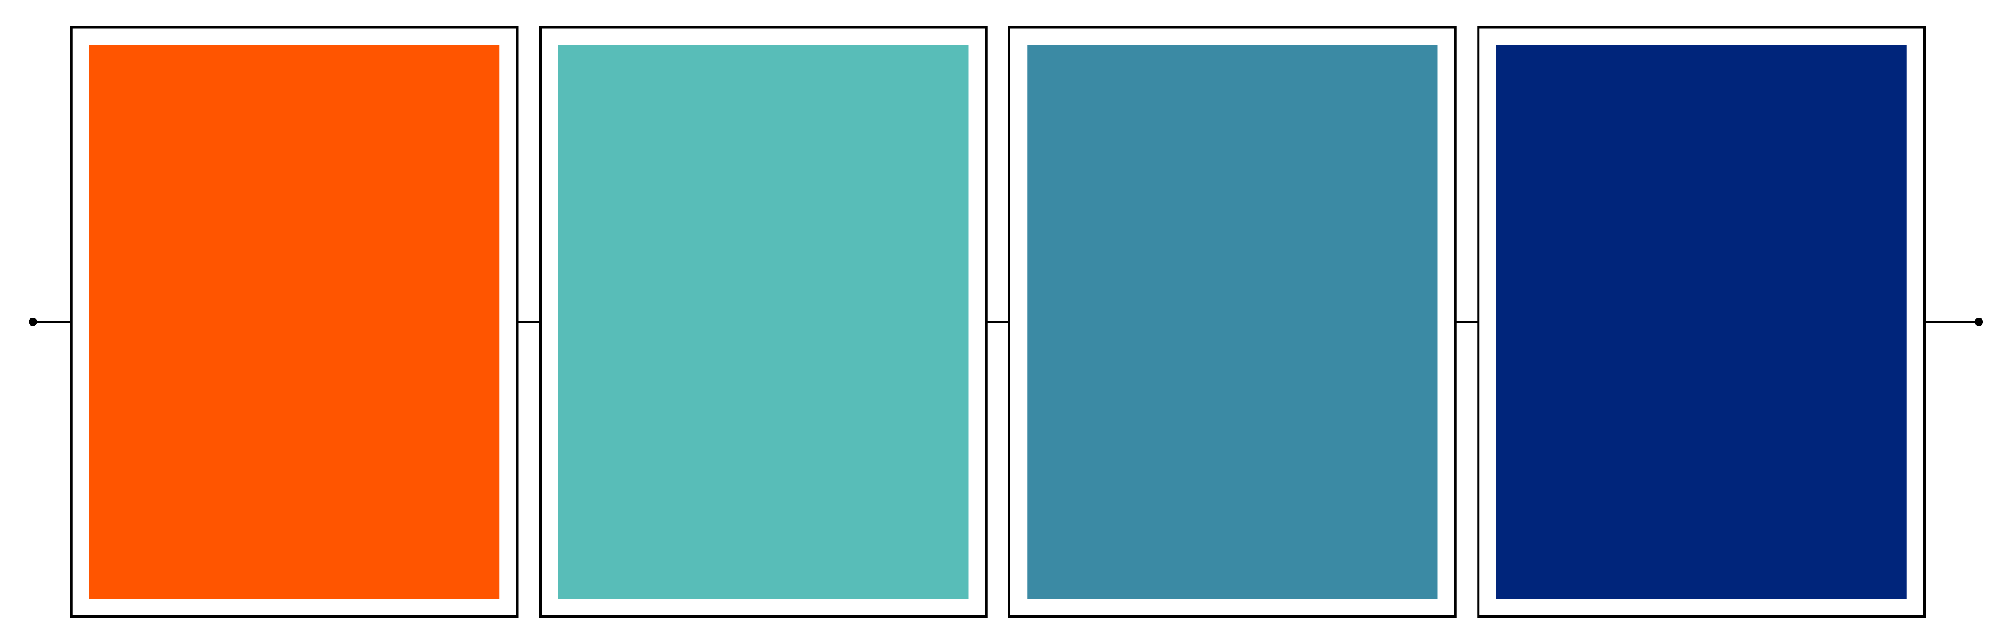

Case study: Safe keeping of legacy data
One of the largest Health systems in North Carolina
The Challenge
The Solution​
1st Year Status​
The Results​
20+ years of patient and financial data across 300+systems
Deployed Triyam’s Fovea for cloud-based archival
108M+ documents
consolidated
Up to 50% reduction in annual ops and maintenance costs
Integrated with Epic EHR and Active Directory SSO​
38M+ patient records archived
Included legacy EHRs (Allscripts, Cerner, DocuWare), RCM and ERP platforms (Lawson, PeopleSoft, TalentPlus)
HIPAA-compliant archival with full audit visibility
Enabled instant search with full audit trails
20+ TB of legacy data secured and searchable
Search time reduced from days to seconds
Disconnected access, high costs, and HIPAA retention needs
Designed a 5-year phased roadmap to archive 60 systems per year
Phase 1 completed successfully — now advancing to the next phase
The information in this document is proprietary and confidential to Triyam and cannot be disclosed without prior written consent.

Slide 20






Closing Remarks – A Quick Recap!
Key Takeaways
Managing the Deluge
Real-World Impact
Healthcare data is projected to reach 10 zettabytes this year which is 30% of global data, doubling every 3 years
Choose the right deployment model – cloud, hybrid, or
on-prem
Triyam helped a leading health system consolidate 20+ years of records, archiving data across 38M+ patients and 108M+ documents.
Use tiered retention – hot, warm, cold, and archive, based on usage & compliance
Data sources range from EHRs and imaging to wearables, smart rooms, and genomics
Put your data to work – clean, curate, and enable federated access for secure analytics and AI readiness
​
Delivered faster access, cost savings, and full compliance
This surge brings immense opportunity and growing complexity
The information in this document is proprietary and confidential to Triyam and cannot be disclosed without prior written consent.

Slide 21





Want the Deck?
Thanks for Joining Us
Let’s continue the conversation. If you’d like to continue the discussion or learn more about how Triyam can support, you or explore potential collaboration—let’s connect.
📧 sudhakar@triyam.com
📧 shawna.serio@triyam.com
Scan & Download
www.triyam.com
info@triyam.com

